Slide 1

CASE STUDY-4
Group-4:
Nirati Khanna
Jyoti kasera
Swati singh
Poornima Raghuwanshi

Slide 2
Agenda
We have Dpt_Details data we need to do some cleaning. In this data, we have duplicate values. We need to divide the data into two different categories. The first category is Columns which are not repeated in the data and their count. The other category is columns which are repeating and their count also. 1. The source file contains Sales records with ID, Name, and Department details. 2. The target table should contain the following columns: ID, Name, Department, and Count details.
Note: Copy the below Source data paste it into the notepad and save it in CSV format. And it should be a comma “,“ delimited file. The file name should be “Dpt_Details”. Load the Target data into Azure SQL Database.

Slide 3
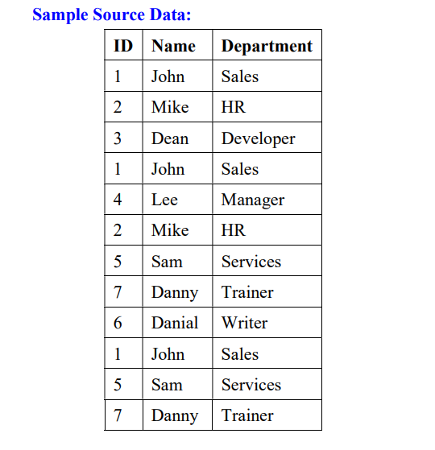
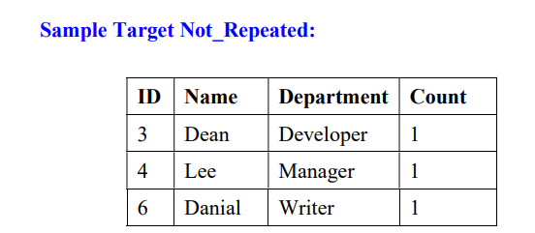
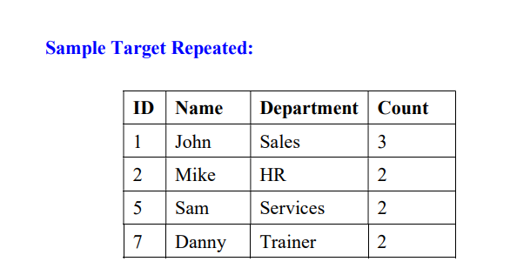

Slide 4
FLOW :
Step1:
Aggregate to count
Split to split tables
Mapping : to remove duplicates
Filter
Conditional
FLOW :

Slide 6
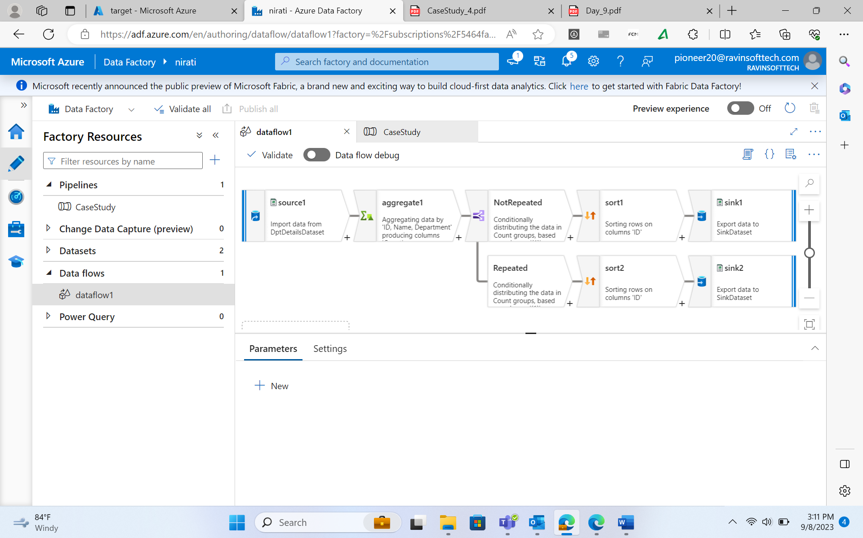

Slide 7
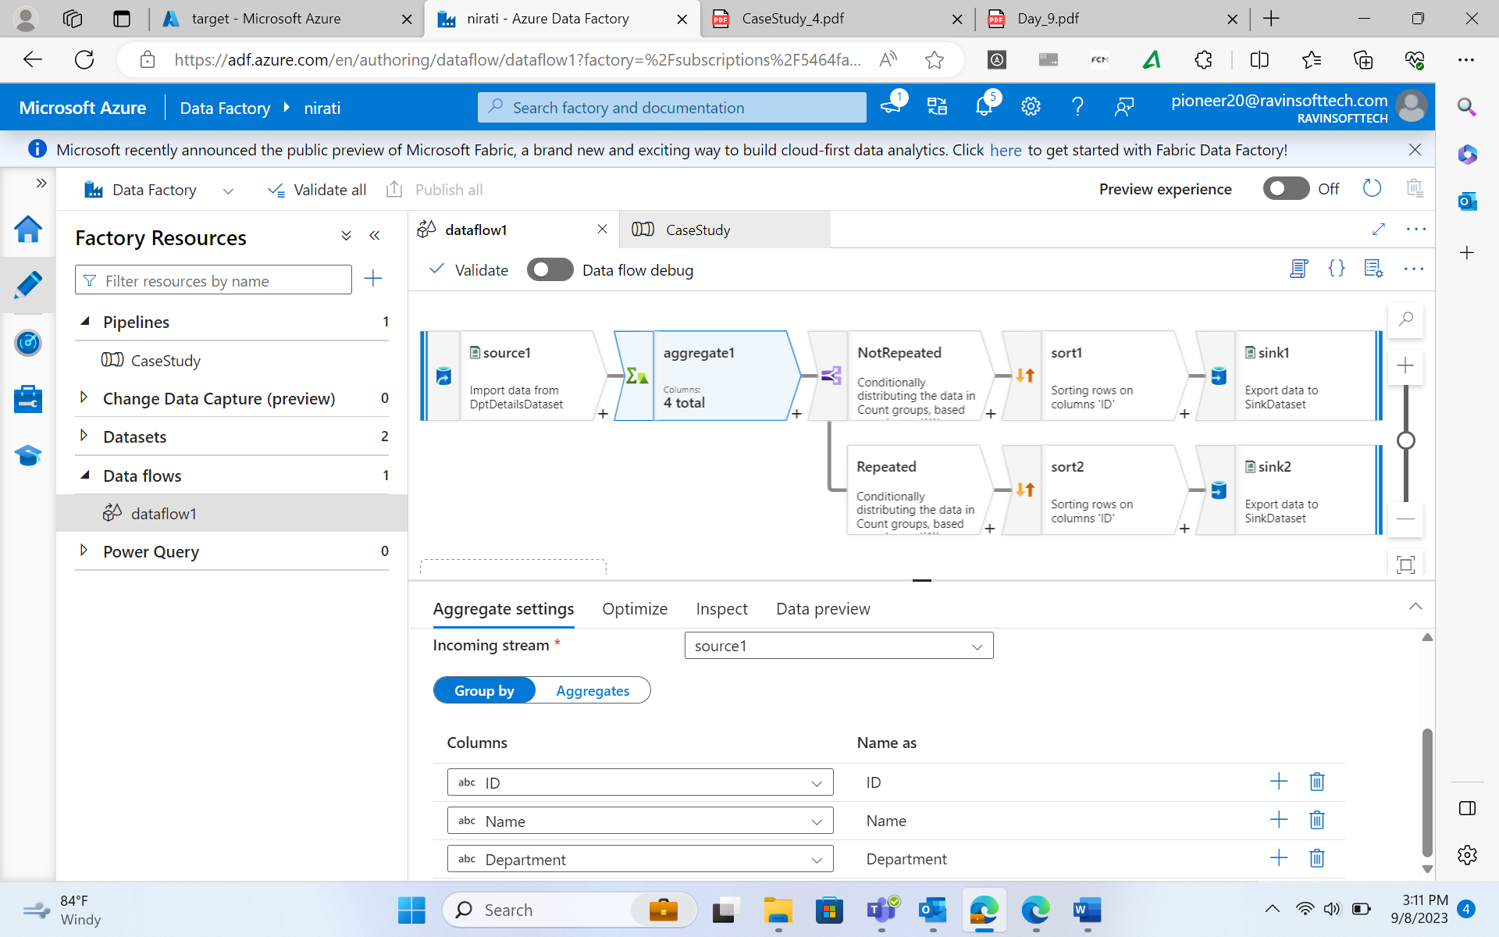

Slide 8
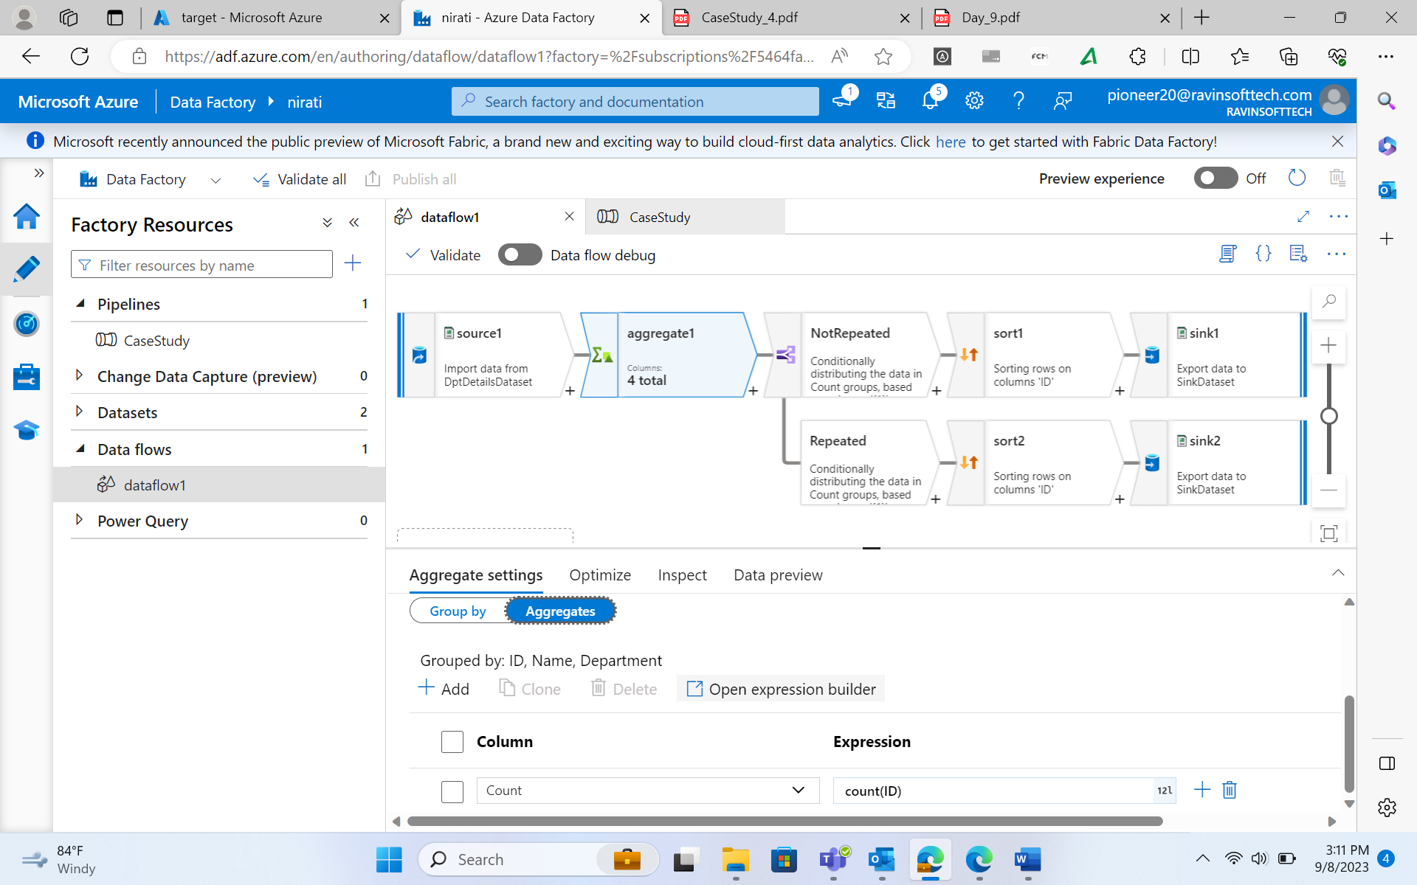

Slide 9
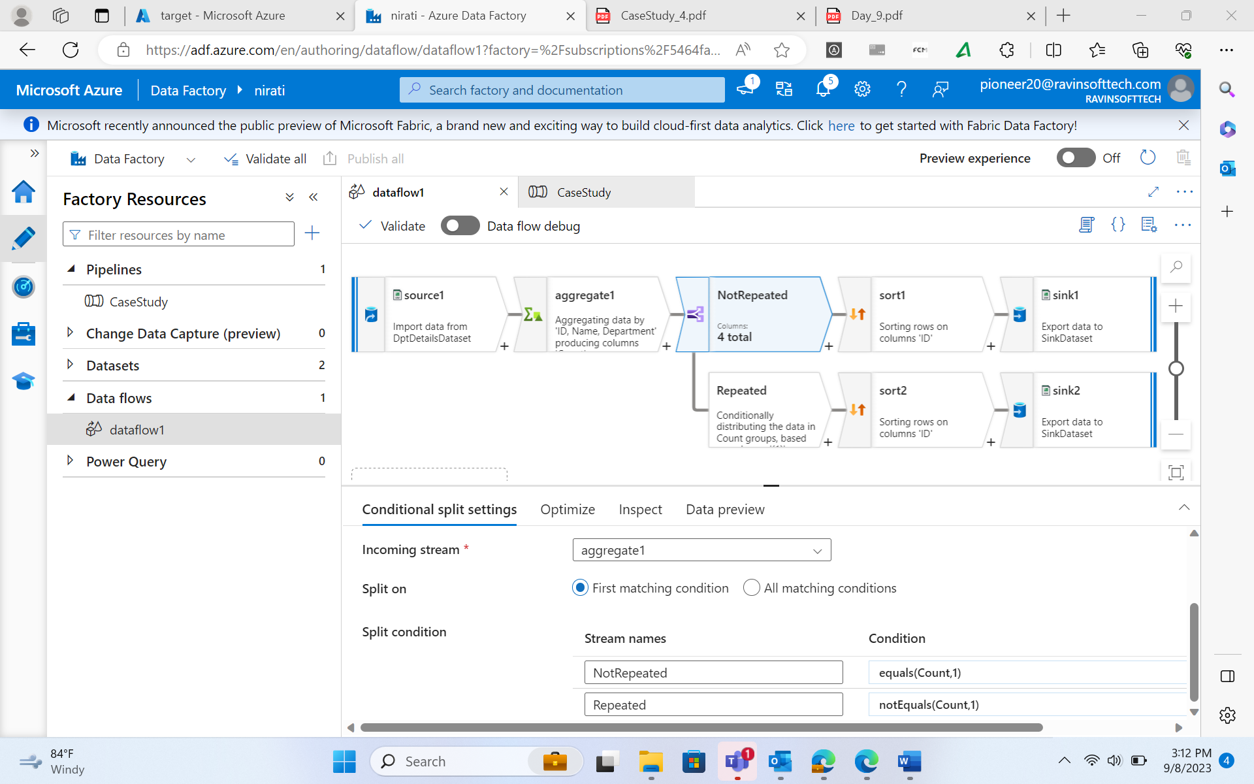

Slide 10
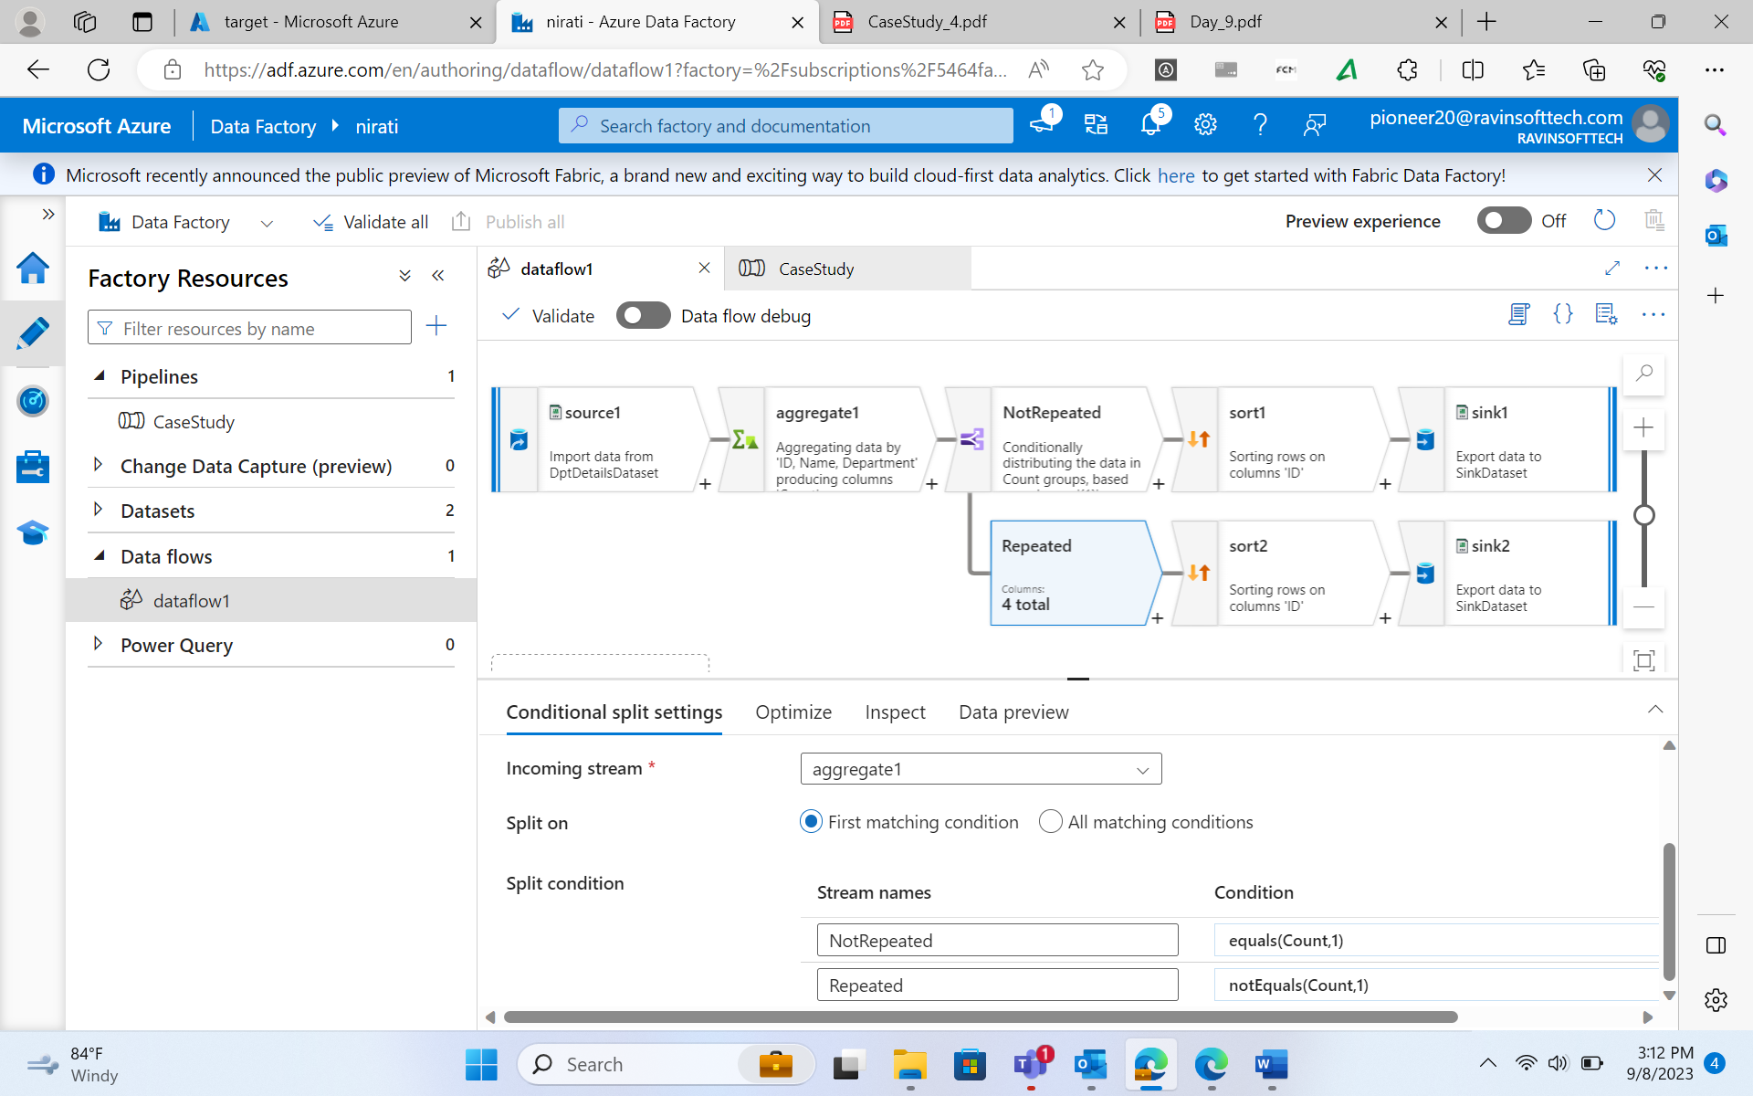

Slide 11
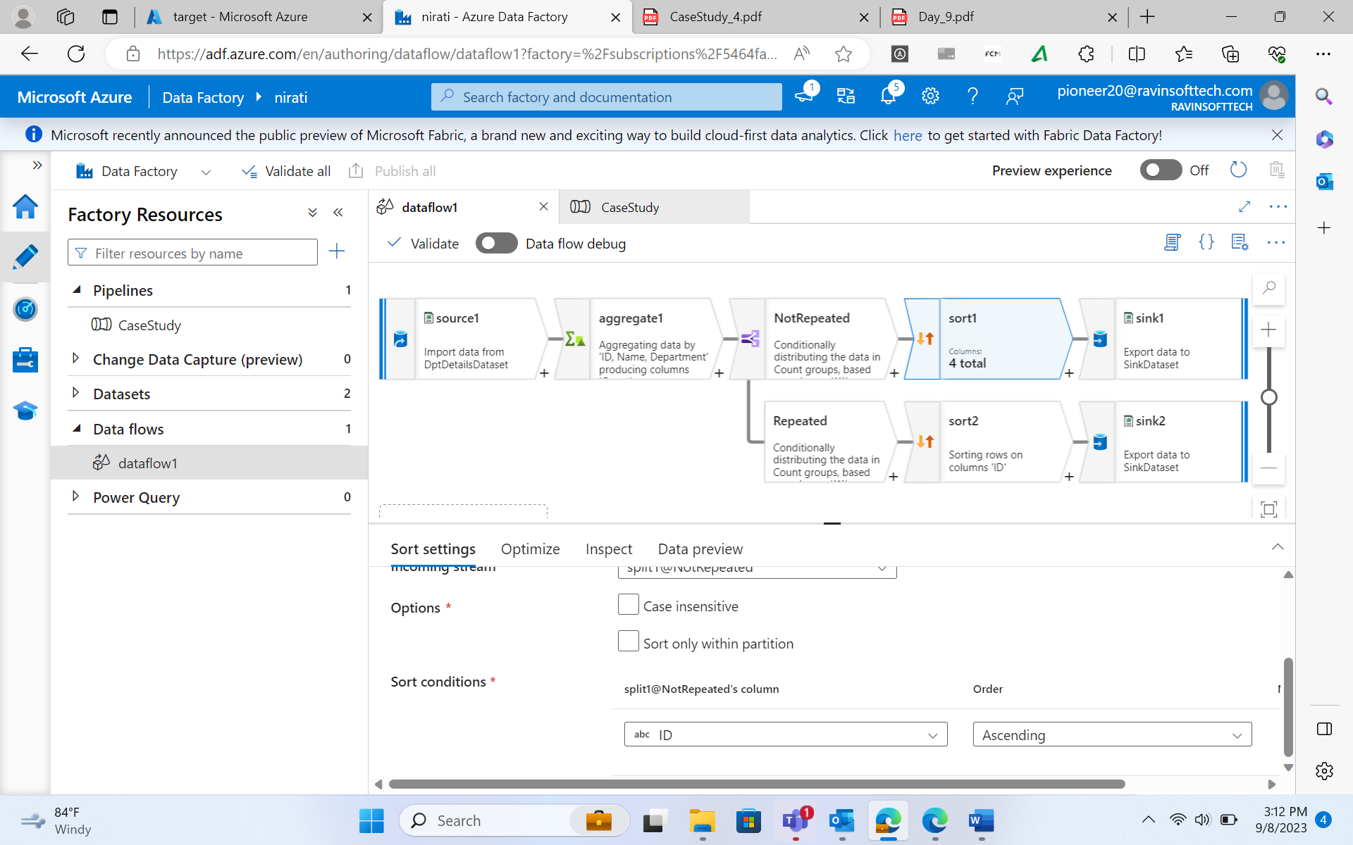

Slide 12
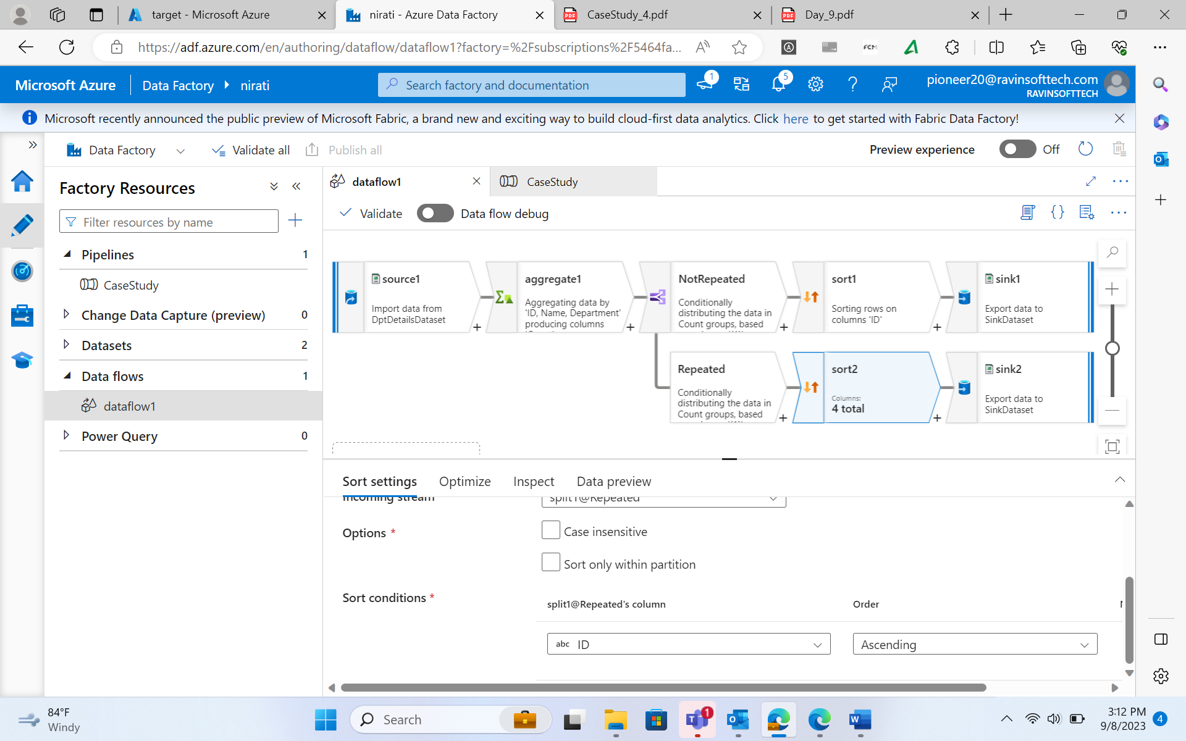

Slide 13
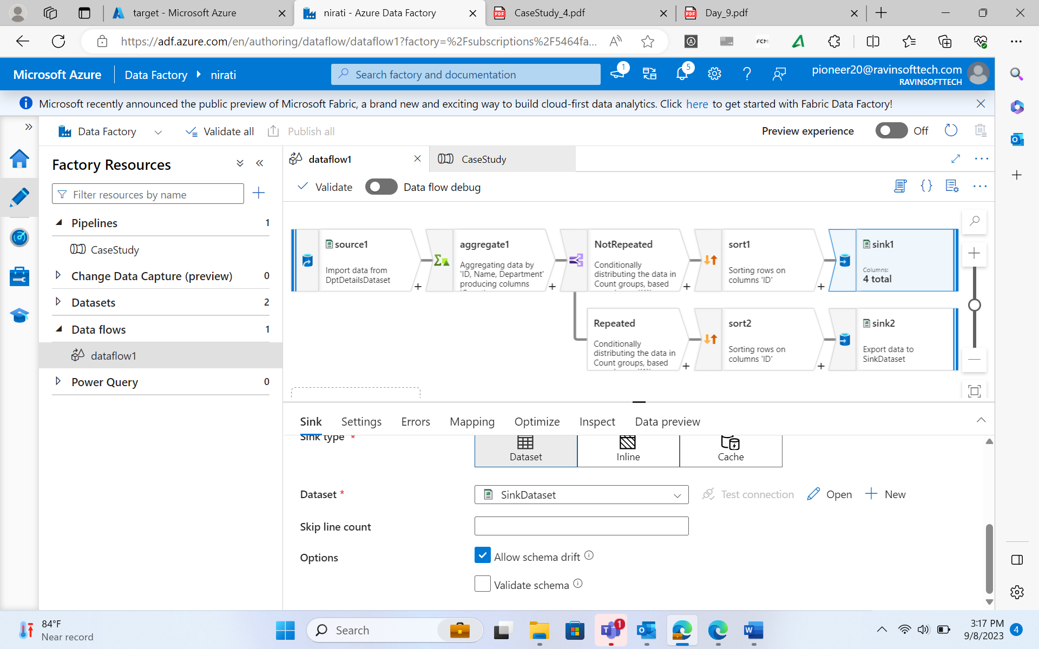

Slide 14


THANK YOU

